Slide 1




Linked Lists
Linked Lists
Notes:
Sequences

Slide 2
Array vs Linked List
Disadvantages of arrays as storage data structures
  The length of a dynamic array might be longer than the actual number of elements that it stores.
  Amortized bounds for operations may be unacceptable in real-time systems.
  Insertions and deletions at interior positions of an array are expensive
  Fixed size
Notes:
Slow searching in unordered array
Slow insertion in ordered array
Sequences

Slide 3
Array vs Linked List
Linked lists
  More complex to code and manage
  Dynamic
    A linked list can easily grow and shrink in size
    Data items (Nodes) are allocated in memory as needed
    A dynamically linked sequence of Nodes
  Easy and fast insertions and deletions
    Only need to modify references: data items stay where they are
Notes:
Sequences

Slide 4
References vs. objects
variable = value
  a variable (left side of = ) is an arrow (the base of an arrow)
  a value (right side of = ) is an object (a box; what an arrow points at)
For the list at right:
  a.next = value
  means to adjust where points
  variable = a.next
  means to make variable point at
2
1
data | next
10
data | next
20
a
1
2
Notes:
Sequences

Slide 5
Reassigning references
when you say:
  a.next = b.next;
you are saying:
  "Make the variable a.next refer to the same value as b.next."
  Or, "Make a.next point to the same place that b.next points."
data | next
10
data | next
20
a
data | next
30
data | next
40
b

Slide 6
The Many-Faced Data Structure
Linked Lists come in many forms
  Single-ended Singly Linked
  Double-Ended Singly Linked
  Circular (Not covered)
  Double-Ended Doubly Linked
  Positional List (not covered)

Slide 7
The Node Class for List Nodes
class Node:
def __init__ (self, element, next=None):
# initialize node’s fields
self.data = element # reference to user’s element
self.next = next # reference to next node
Linked Lists

Slide 8
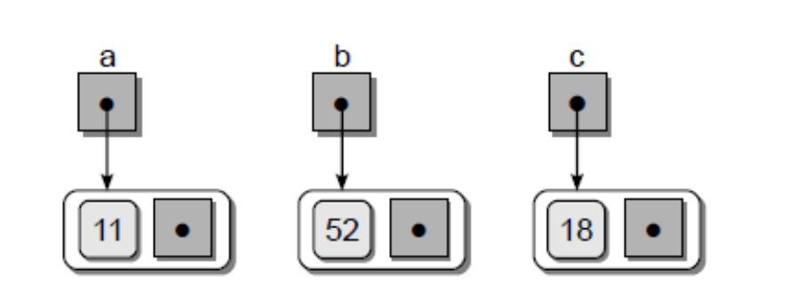
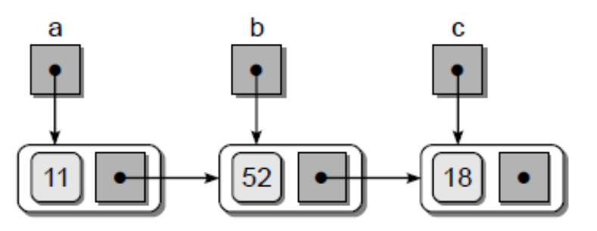
Creating a LinkedList
a = Node( 11 )
b = Node( 52 )
c = Node( 18 )
a.next = b
b.next = c
Linked Lists

Slide 9
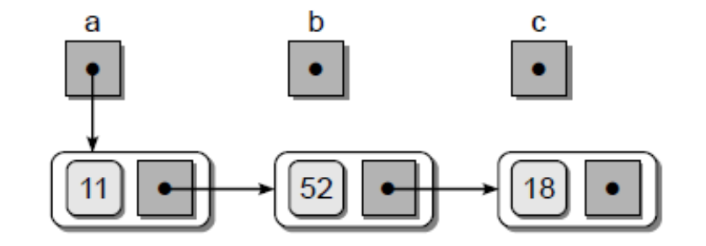
Creating a LinkedList
b = None
c = None
print( a.data ) # Output: 11
print( a.next.data ) # Output: 52
print( a.next.next.data ) # Output: 18
Linked Lists

Slide 10
More terminology
A node's successor is the next node in the sequence
  The last node has no successor
A node's predecessor is the previous node in the sequence
  The first node has no predecessor
A list's length is the number of elements in it
  A list may be empty (contain no elements)

Slide 11
Singly Linked List
A singly linked list is a concrete data structure consisting of a sequence of nodes, starting from a head pointer
Each node stores
  element
  link to the next node
next
elem
node
head
∅
A
B
C
D
Linked Lists
Notes:
A single-ended singly linked list
Sequences

Slide 12

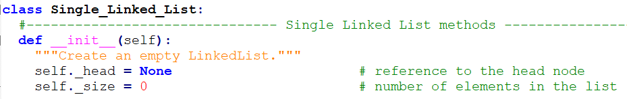
Python class of SLL
Linked Lists

Slide 13
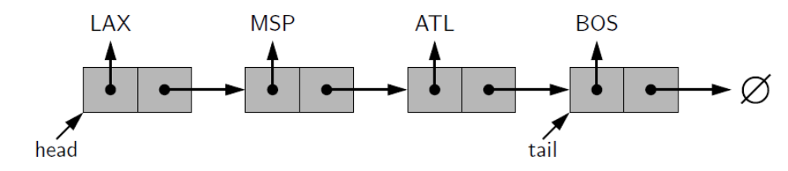
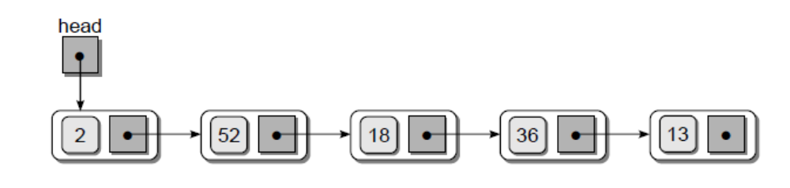
Other Single LinkedLists
∅
Linked Lists
Notes:
Double-ended singly linked list: head and tail pointers
Sequences

Slide 14
Operations on an SLL
Insertion
Deletion
Search or Iteration through the list to display items

Slide 15
Inserting/Removing an SLL Node
Many ways to insert/remove a list node
  As the new first element
  As the new last element
  Before a given node (specified by a reference)
  After a given node
  Before a given value
  After a given value
All are possible, but differ in difficulty

Slide 16
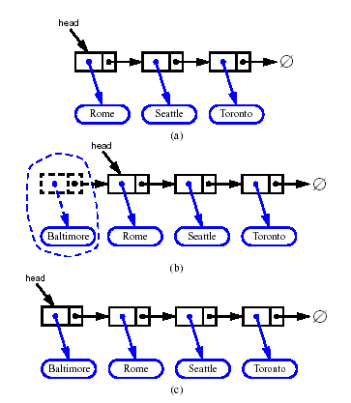
Inserting at the Head
Allocate a new node
Insert new element
Have new node point to old head
Update head to point to new node
Linked Lists
Notes:
Algorithm add first(L,e):
newest = Node(e) {create new node instance storing reference to element e}
newest.next = L.head {set new node’s next to reference the old head node}
L.head = newest {set variable head to reference the new node}
L.size = L.size+1 {increment the node count}
Sequences

Slide 17
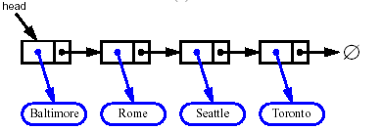


Removing at the Head
Update head to point to next node in the list
Allow garbage collector to reclaim the former first node
Linked Lists
Notes:
Algorithm remove first(L):
If L.head is None then
Indicate an error: the list is empty.
L.head = L.head.next {make head point to next node (or None)}
L.size = L.size−1 {decrement the node count}
Sequences

Slide 18
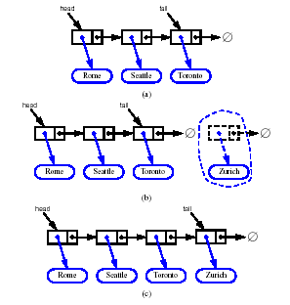
Inserting at the Tail
Allocate a new node
Insert new element
Have new node point to null
Have old last node point to new node
Update tail to point to new node
Linked Lists
Notes:
Algorithm add last(L,e):
newest = Node(e) {create new node instance storing reference to element e}
newest.next = None {set new node’s next to reference the None object}
L.tail.next = newest {make old tail node point to new node}
L.tail = newest {set variable tail to reference the new node}
L.size = L.size+1 {increment the node count}
Sequences

Slide 19
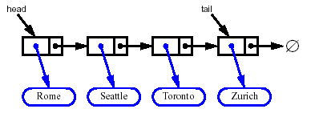
Removing at the Tail
Removing at the tail of a singly linked list is not efficient!
There is no constant-time way to update the tail to point to the previous node
Linked Lists

Slide 20
Traversing the Nodes
def traversal(self):
while self._head is not None :
print(self._head.data)
self._head = self._head.next
∅
Any issue here?
Linked Lists
Notes:
What’s the problem here?
Head reference will disappear after
Sequences

Slide 21
Traversing the Nodes
def traversal(self):
curNode = self._head
while curNode is not None :
print(curNode.data)
curNode = curNode.next
∅
Linked Lists

Slide 22
Traversing an SLL
Green arrow: assign a value to curNode
curNode
head
one
two
four
Traverse to the next node: curNode = curNode._next

Slide 23
Searching for a Node
def unorderedSearch(target):
curNode = self._head
while curNode is not None and curNode.data != target:
curNode = curNode.next
return curNode is not None
∅
Linked Lists

Slide 24
Linked List Efficiency
Insertion and deletion at the beginning of the list are very fast
O(1)
Search, deletion, insertion require traversal
O(n)
Same number of comparisons as arrays
But no shifting of items required after insertion or deletion
Memory print strictly limited to usage and can shrink/expand (No need to pre-allocate with capacity)

Slide 25
Let’s Implement Single Linked List
Download Single_linked_list_Students.py from Brightspace.
Complete the insertAtFirst(e), deleteFirst() functions.
Upload your solution to Gradescope
Linked Lists

Slide 26
Stack as a Linked List
We can implement a stack with a singly linked list
The top element is stored at the first node of the list
The space used is O(n) and each operation of the Stack ADT takes O(1) time
nodes
t
∅
elements
Linked Lists

Slide 27
Let’s Implement a stack
Among the functions that we implemented in Single_linked_list_Students.py, i.e insertAtFirst(e), deleteFirst(), unOrderedSearch(e) functions,
which one can be applied to:
  push(e)
  pop()
Linked Lists

Slide 28
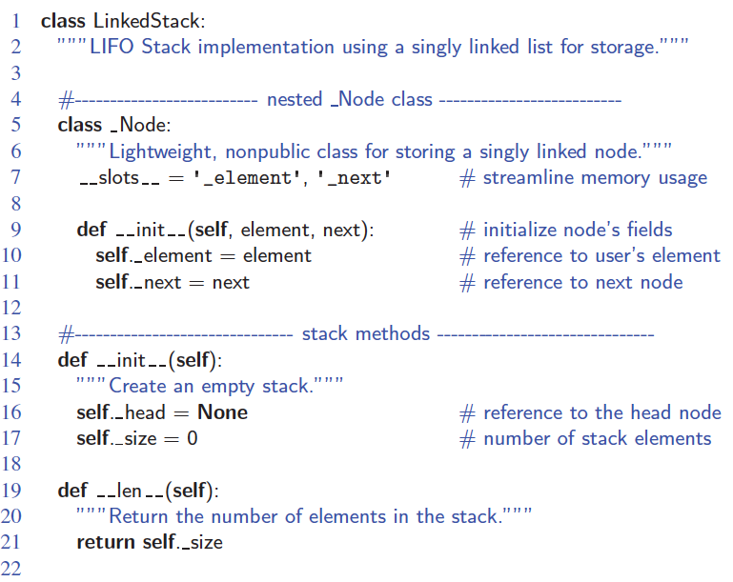
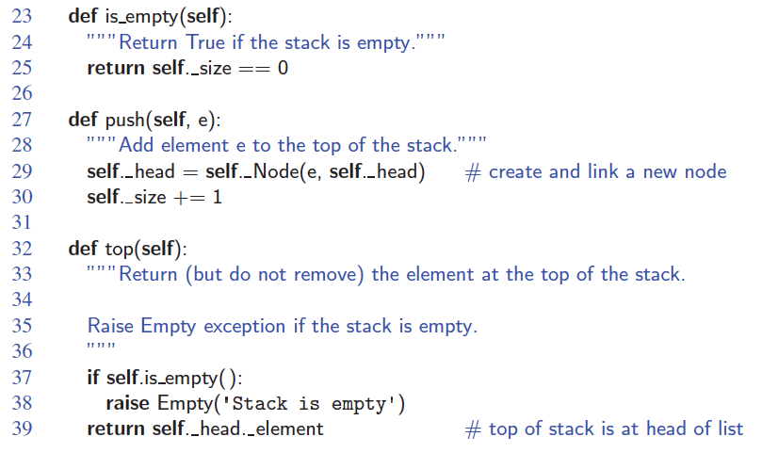
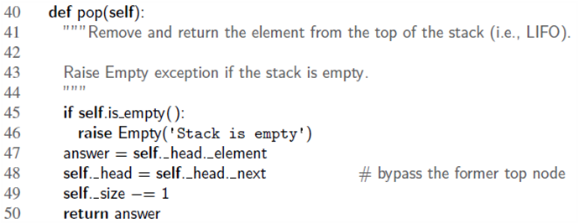
Linked-List Stack in Python
Push: insertAtFirst
Pop: deleteFirst
Linked Lists

Slide 29
Queue as a Linked List
We can implement a queue with a singly linked list
  The front element is stored at the first node
  The rear element is stored at the last node
The space used is O(n) and each operation of the Queue ADT takes O(1) time
r
nodes
f
∅
elements
Linked Lists

Slide 30
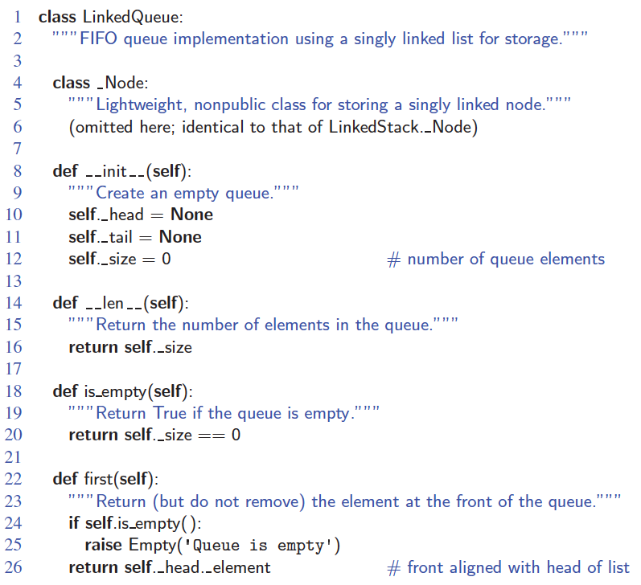
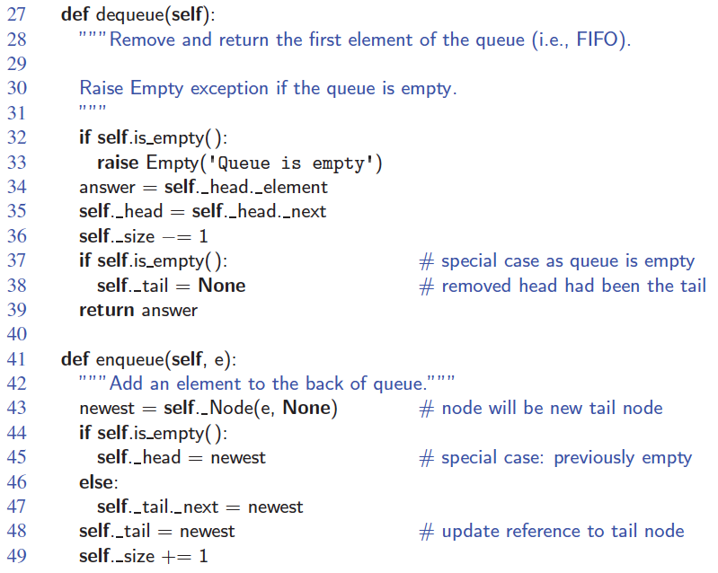
Linked-List Queue in Python
Linked Lists
Notes:
Edge case: when deleting a node in a list which has only one node. Tail needs to reset to None
Sequences

Slide 31
Queue as a Linked List
Special Cases:
When dequeue the last element, self._tail should be None too. That is, both self._head and self._tail should be None.
When enqueue the first element, self._head should be newNode (line 45 in previous slide) too. That is, both self._head and self._tail should be newNode.
To avoid the special cases, use header & trailer sentinels (we will see them in doubly-linked list soon)

Slide 32
Inserting After
(More Operation of SLL)
node
three
p
1) node._next = p._next
numerals
2) p._next = node
one
two
four
Find the node you want to insert after
First, copy the link from the node that's already in the list
Then, change the link in the node that's already in the list

Slide 33
Deleting an Element From an SLL (More Operations of SLL)
• To delete the first element, change the link in the header
numerals
header = header._next
one
two
three
• To delete some other element, change the link in its predecessor
predecessor._next = p._next
numerals
one
two
three
• Deleted nodes will eventually be garbage collected
p

Slide 34
LinkedLists in Action
Visualization time
  https://visualgo.net/en/list

Slide 35
The Many-Faced Data Structure
Linked Lists come in many forms
  Single-ended Singly Linked (head)
  Double-Ended Singly Linked (head + tail)
  Circular (Not covered)
  Double-Ended Doubly Linked (next ppt)
  Positional List (Not covered)

Slide 36
LinkedLists in Action
Chapter 7 of text book and Exercises
https://www.geeksforgeeks.org/data-structures/linked-list/
https://leetcode.com/tag/linked-list/
Some slides have been prepared/taken from textbook’s Website.
Visualization time
  https://visualgo.net/en/list

